Slide 1





Longitudinal data, trajectories and telemonitoring: how to analyze them? Example of sleep data
Doctorantes : Ina Jandric – Ophélie Coiffier
Encadrant : Sébastien Bailly

Slide 2
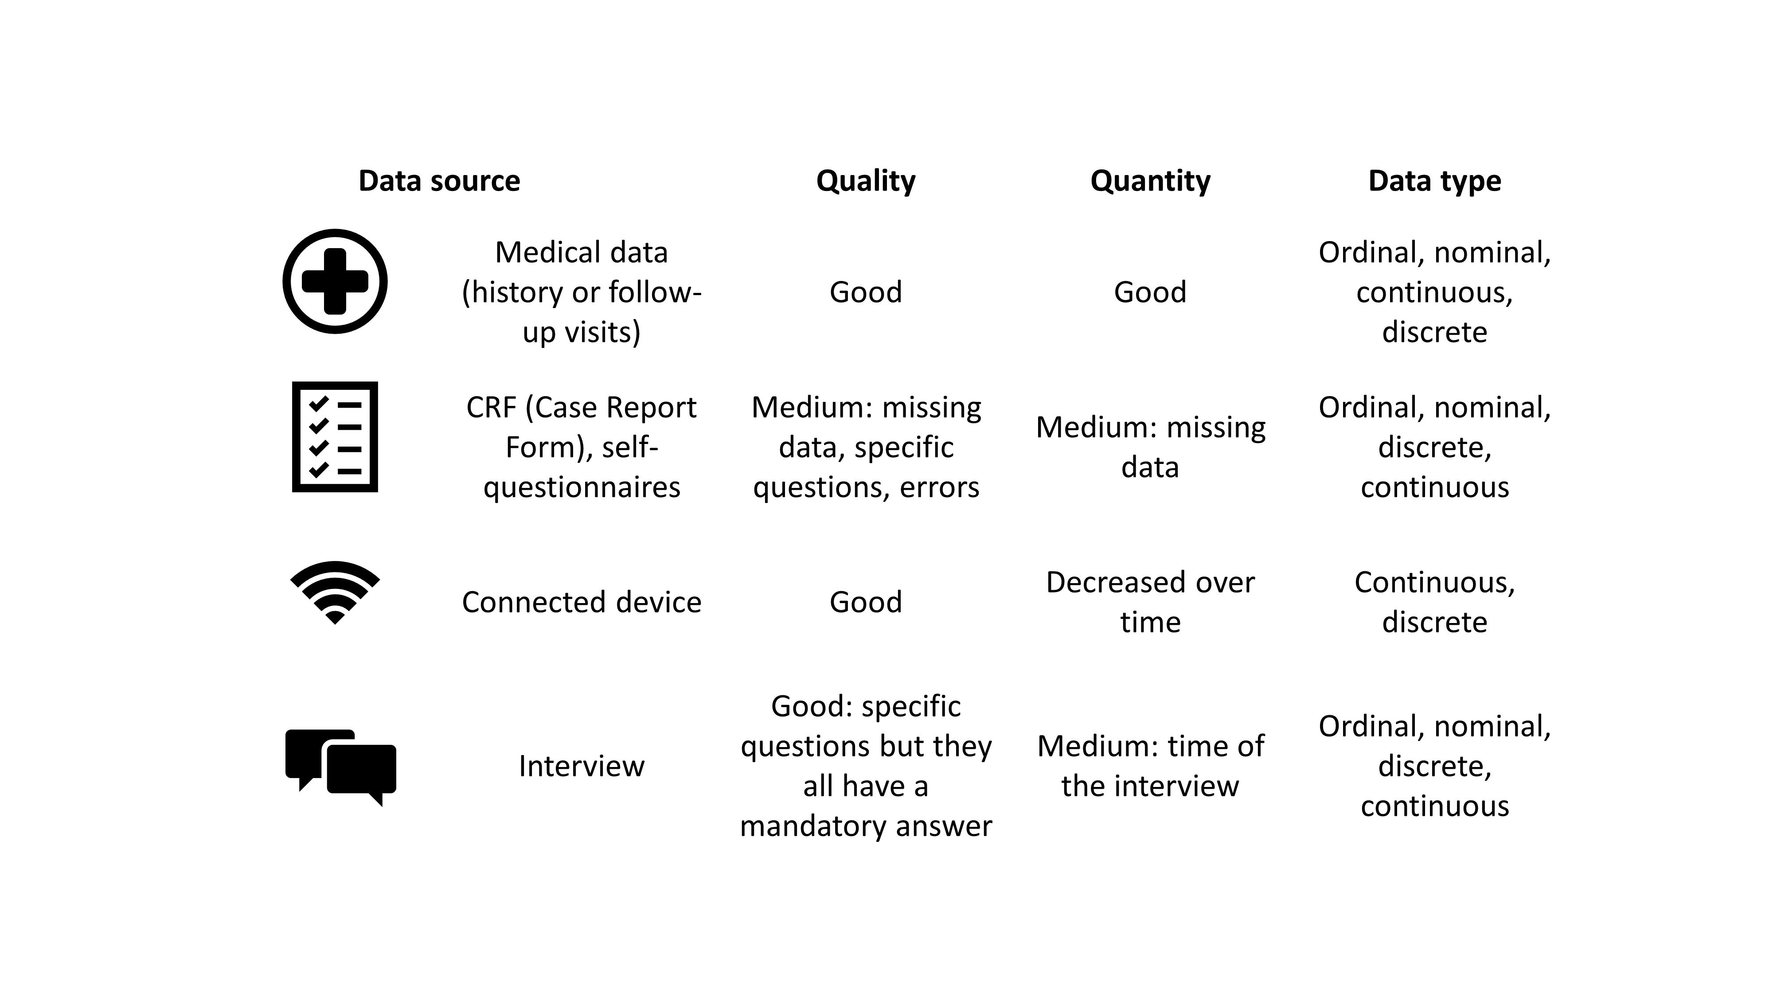
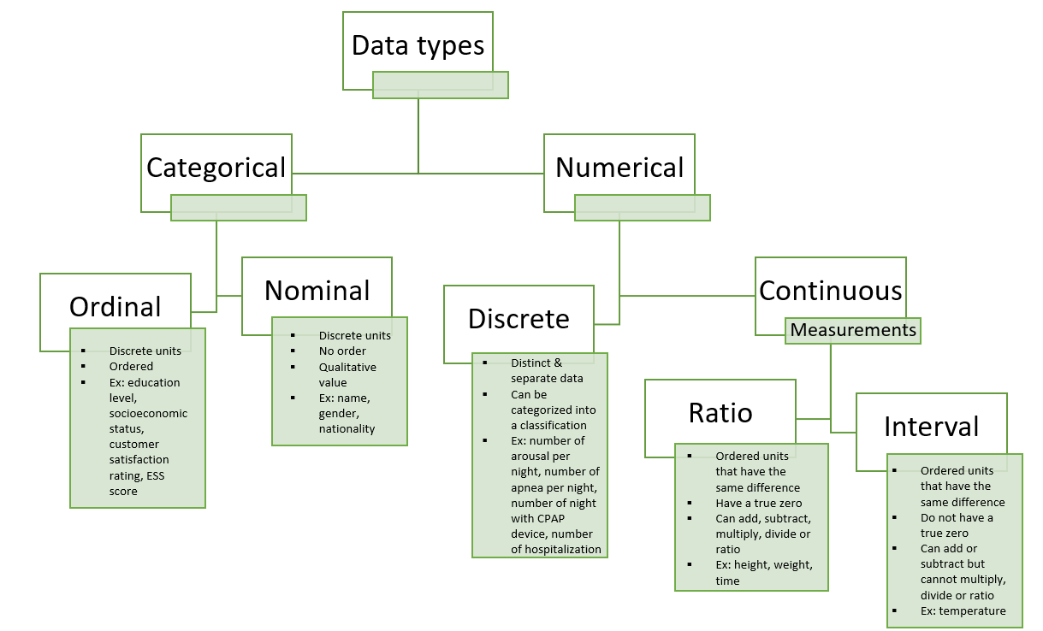
Type and source of the data

Slide 3
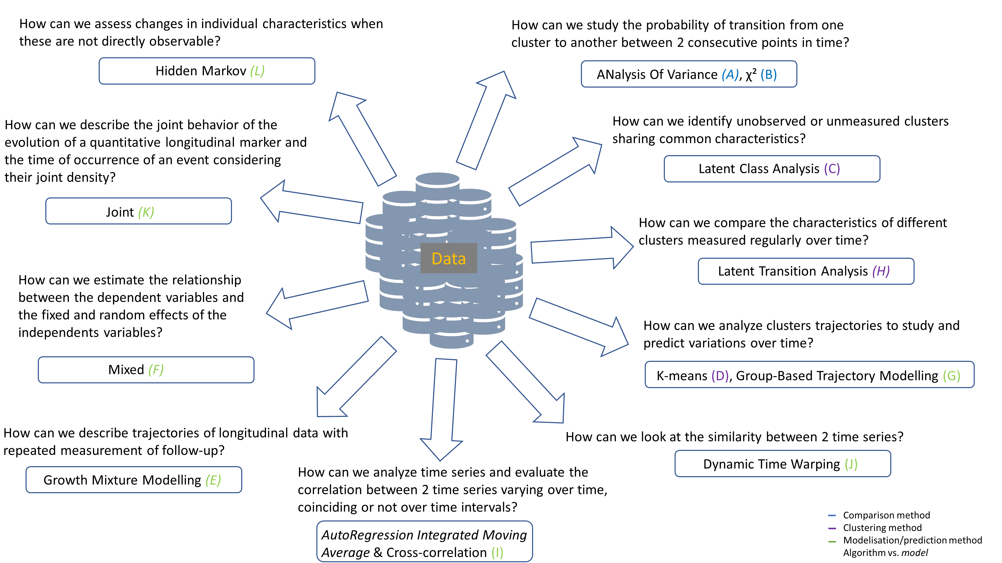
Question and goals of the study

Slide 4
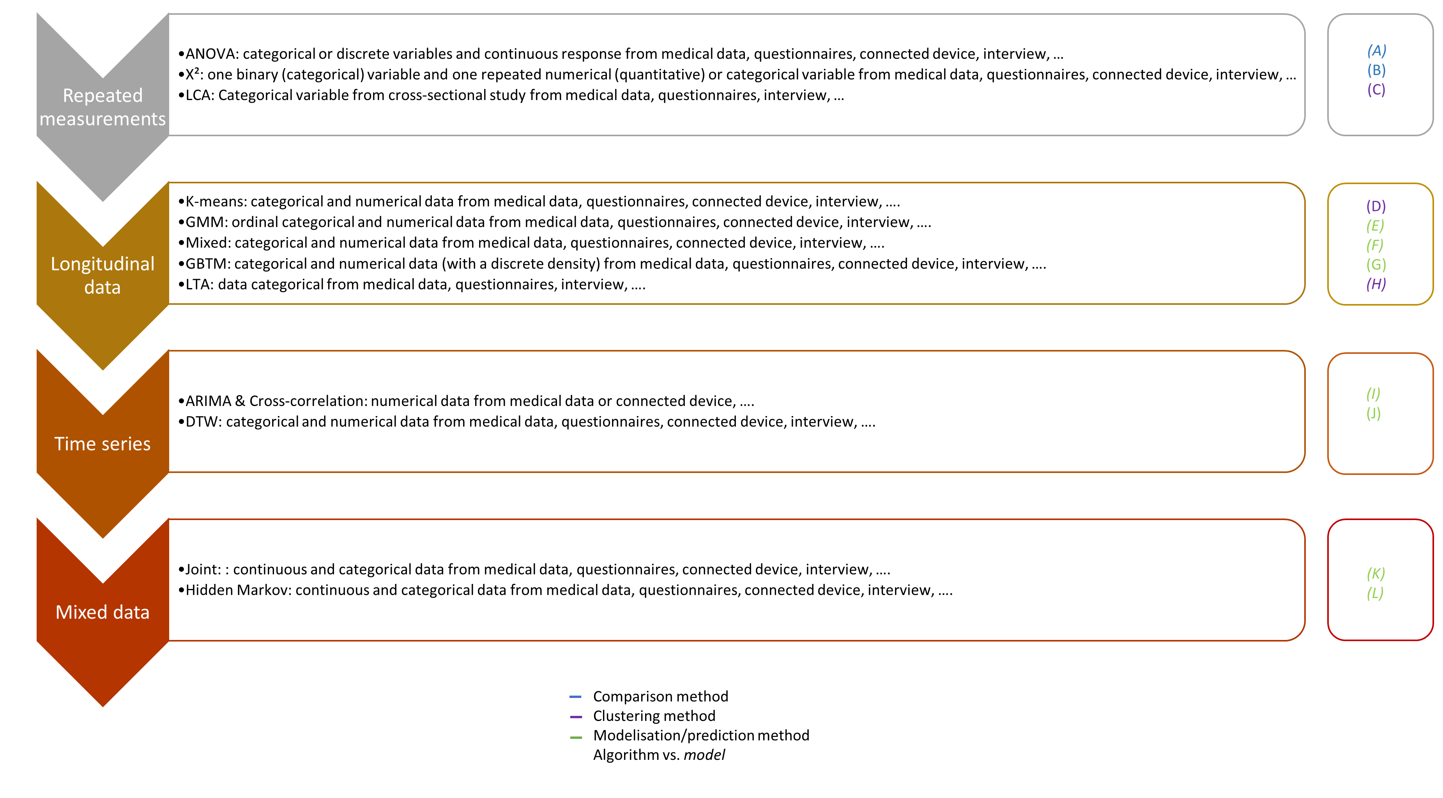
What statistical method use?

Slide 5
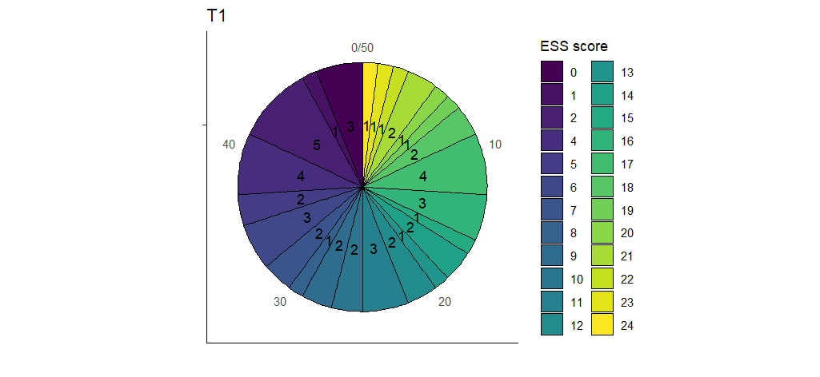
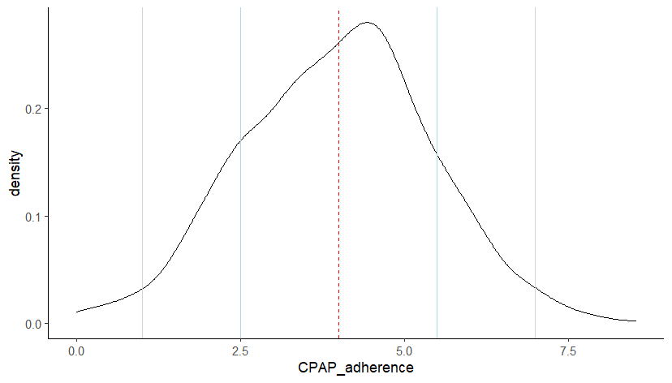
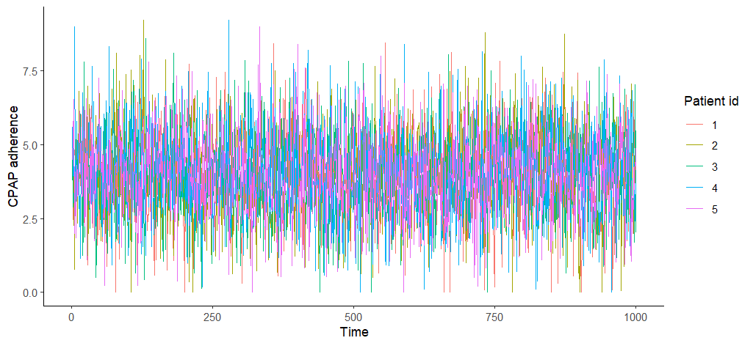
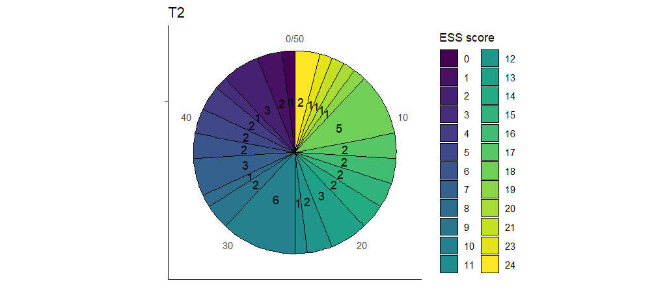
Example using sleep data
Observance PPC
Score ESS
2σ
μ
σ
50 patients
N(4, 1.5)
Valeurs >0 uniquement
1000 time points
5

Slide 6

Questions?

